Slide 1
Understanding the Relationship Between Hosts and Their Microbiome
Dr. Boahemaa Adu-Oppong
Monsanto Computational Microbiologist Position
Advisor: Gautam Dantas
September 15, 2017

Slide 2
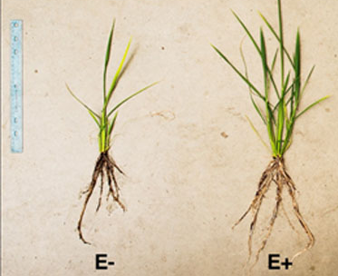
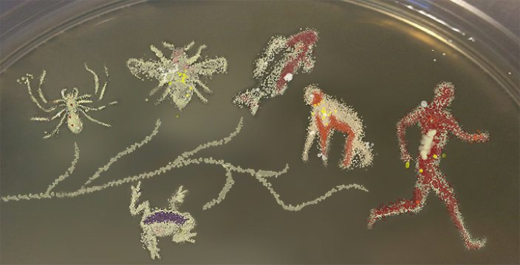
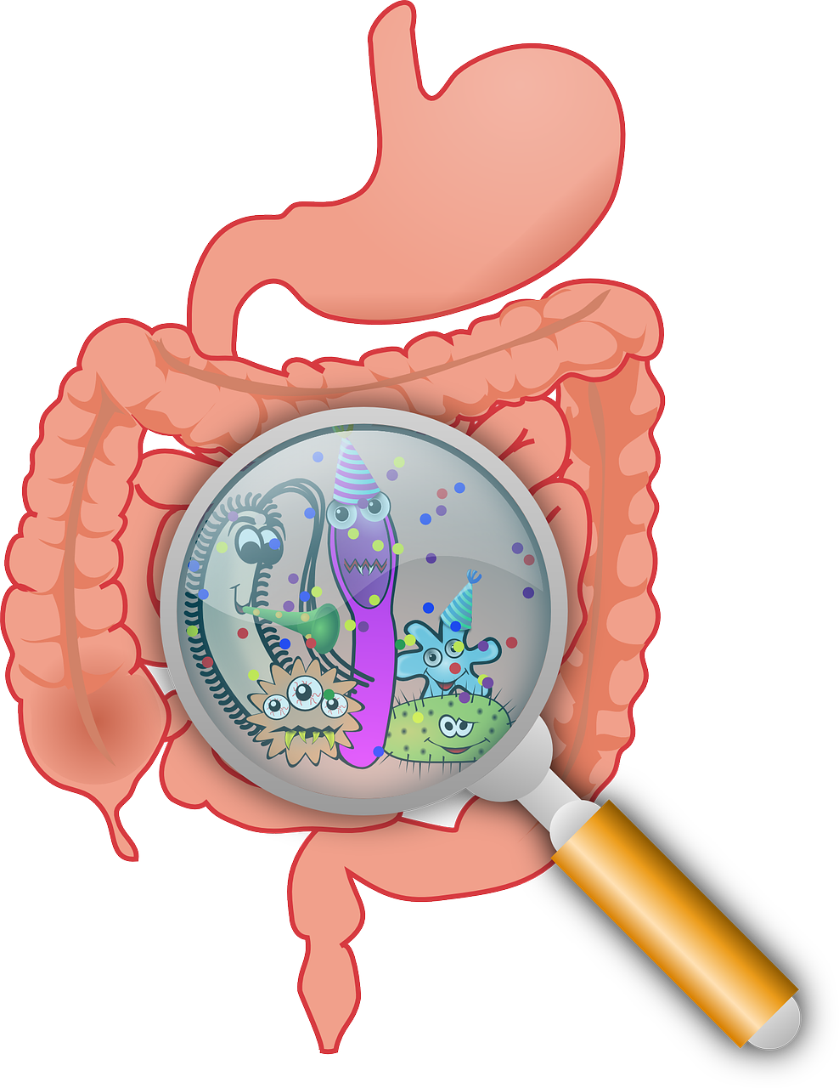
Complex microbial communities serve important functions in every environment
Zareen Khan et al. Current Plant Biology 2016; Hacquard et al. Cell Host & Microbe Review 2015
Notes:
Microbes are associated with every eukaryote on this planet and aid in the evolution of many organisms by allowing their hosts to access new niche spaces or by the creation of new species by reproductive isolation. Microbes also serve important functions for their hosts. For example, plants which are supplemented with beneficial microbes are able to tolerate drought. Microbes in human guts ferment indigestible polysaccharides into short chain fatty acids. In both plants and humans, microbes can play a protective role by competitive exclusion against invasion by opportunistic pathogens. However, we are left to wander if similar niches despite individual variation will enrich for similar species and we wonder what is driving the composition of microbial communities.

Slide 3
Do microbial communities play a role in shaping who we are?
Assembly
How did they get there?
What are they?
What are they doing?
Composition
Function
Notes:
In order to answer these questions, we decided to study these microbial communities within the framework of community ecology. The first question we posed was “How did they get there?”. To study this question we have to understand what forces or lack of forces are driving the structure of the community. The second question we posed was “What are they?”. Meaning, what species are in these different communities. Thirdly, we sought to answer the question “What are they doing”. With this question, we will be able to understand what benefit the host receives from forming a symbiotic relationship with bacterial communities.

Slide 4

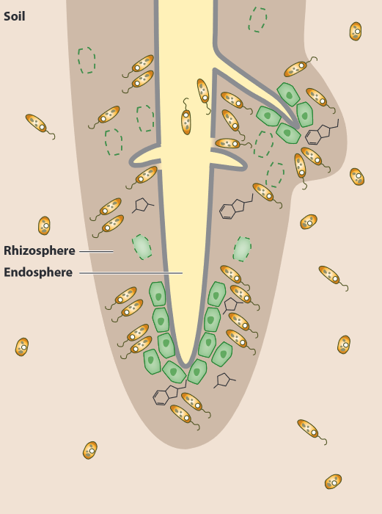
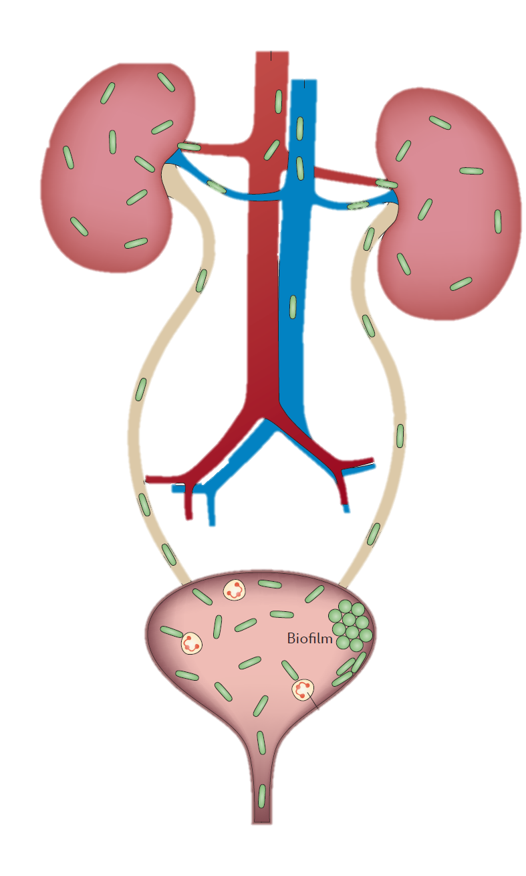





Assembly, composition and function of Microbial Communities in Plant Roots
Evaluation of culture based and independent methods to Characterize the Microbial Community of Human Urine
Bladder
Notes:
To study these three questions, I used two hosts. First I studied the bacteria that inhabit the inside of plant roots, particularly prairie plants and I studied the bacteria that reside inside of the bladder in the context of Urinary Tract Infections. Now, I will tell you about the plant root project which was done in collaboration with Scott Mangan, Claudia Stein, Christopher Catano and Jonathan Myers who are all at WashU.

Slide 5
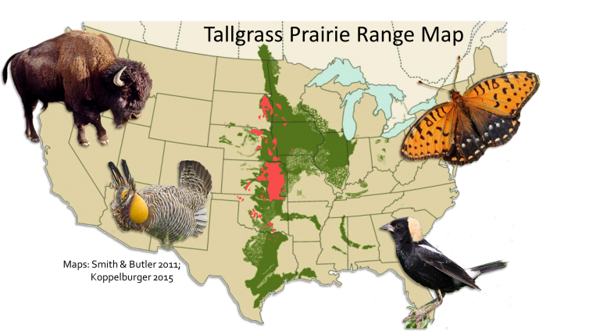
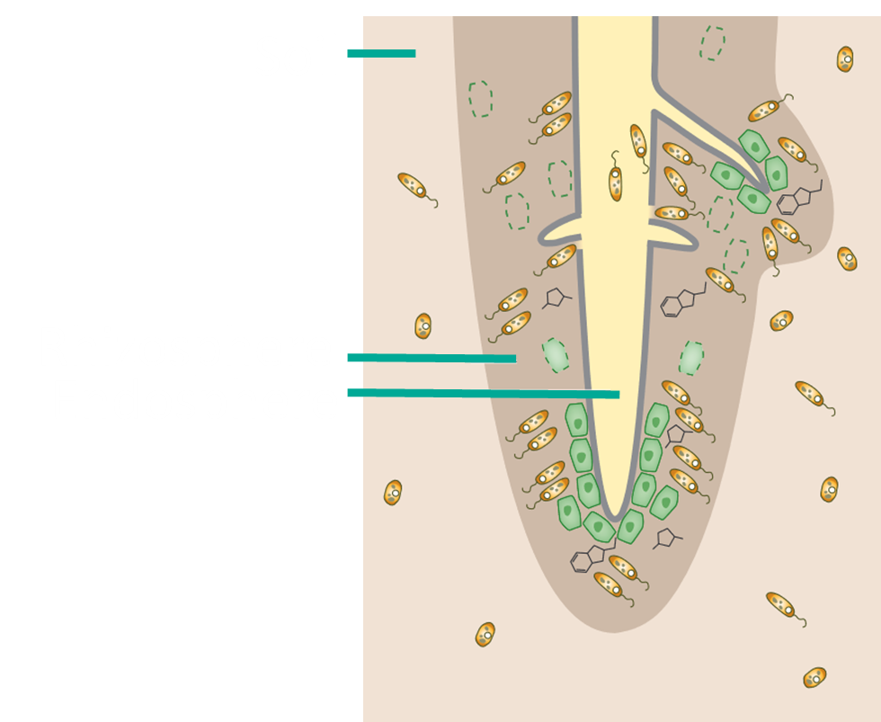
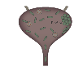
Loss of the tallgrass prairie negatively impacts Earth’s ecosystems and biodiversity
American Bison
Endangered ecosystem due to
Conversion to farmlands
Habitat fragmentation
Loss of native grazers
Retained 13% of historical range
1/3 of species considered endangered are found in grasslands
Superior carbon sinks compared to forests
Regal fritillary
Greater Prairie Chicken
Bobolink
Fierer et al 2013, Samson et al 2004; https://www3.beacon-center.org/blog/2016/04/09/can-evolution-help-us-rebuild-native-habitats/
Notes:
The tallgrass praire is one of the Earth’s most endangered ecosystem due to these lands being converted to farmlands during the European settlement in the mid 19th century. This caused habitat fragmentation and further loss of native grazers such as the American bison pictured here. Only 13% of the historical range is intact today which means endemic species are going extinct. To be exact about a 1/3 of all endangered species are native to grasslands. A few of those species are pictured on this slide. Prairies can help combat global warming because they are great carbon sinks (even better than forests) by absorbing CO₂ that would be normally trapped in our atmosphere increasing temperatures across the globe. We could combat these problems by restoring our prairies but first we have to understand the abiotic and biotic factors that can help increase biomass.
Historical North American tallgrass prairie range in dark green; estimated remaining range in red. Prairie species pictured: American bison (Bison bison), Greater Prairie Chicken (Tympanuchus cupido), Regal fritillary (Speyeria idalia), and Bobolink (Dolichonyx oryzivorus).
https://www3.beacon-center.org/blog/2016/04/09/can-evolution-help-us-rebuild-native-habitats/

Slide 6
Variety of niches at the root-soil interface
Bacteria
Soil
Living root cap border cell
Rhizosphere
Decaying root cap border cell
Endosphere
Organic compounds released by rhizodeposition
Bulgarelli et al. Annual Reviews Plant Biology 2013
Notes:
We decided to study biotic factors which could impact biomass. Specifically we wanted to study the microbes at the root-soil interface. From outside to inside, the habitats are the soil, rhizosphere, and endosphere. Rhizodeposits generated from root cap border cells and the rhizodermis provoke a shift in the soil biome. Cellular disjunction (cells breaking apart) at the root surface during lateral root emergence (when plant roots are growing) provides a potential entry gate for the rhizosphere microbiota into the root interior.
A habitat is a specific place occupied by a community of organisms for growth and reproduction. Thus, plant organs colonized by microbial communities with a distinctive phylogenetic structure represent different habitats.
Simulate soil microbial multiplication in the vicinity of root tissues because most known bacteria are organotrophs
Niche is defined as the totality of biological and environmental factors that affect a species in a habitat, and includes how a species uses this environment.
Niche differentiation at the root-soil interface.

Slide 7
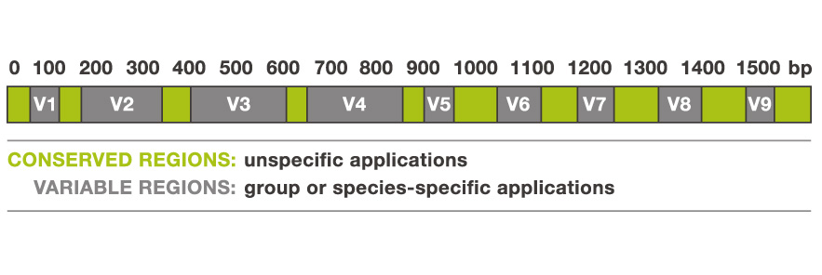
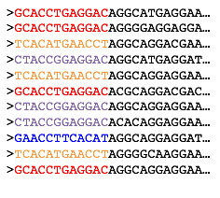
Characterize bacterial communities by culture independent methods
16S rDNA $≈$Operational Taxonomic Units
Streptomyces scabiei
Rhizobium leguminosarum
Sphingomonas wittichii
Caporaso et al. 2011 PNAS
Notes:
To study bacteria, we first need to a way of classifying species. Microbiologist look at the 16S rRNA, a highly conserved gene, to classify bacterial species. We PCR and amplify just a portion of the gene which consists of both conserved and variable regions. After amplification, we sequence the genes and generate a list of DNA sequences. We take the DNA sequence and and we align our reads to a database with known 16S rRNA genes in order to classify our reads. After classification, we can go back to our DNA sequences and measure relative abundance for each species.

Slide 8
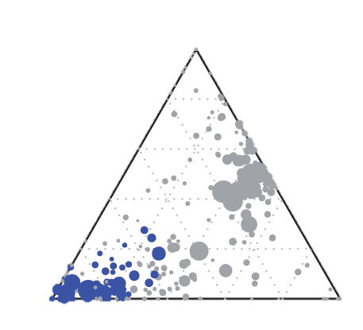
Endosphere contains bacteria that are compositionally distinct from nearby habitats
Soil
Soil
Rhizosphere
Endosphere
Endosphere
Rhizosphere
Bulgarelli et al. Nature 2012
Notes:
Previous studies have shown differences in these niche spaces. This is a terenary plot and each edge of the triangle represents the 3 habitats. The circles represent OTUs or bacterial species and the size of the circles correspond to the abundance of that species. The position of the circles demonstrate whether that bacterial species was sequenced from that habitat. The blue circles indicate the species which were enriched in the endosphere proving that the composition of the bacterial community in the endosphere is unique. Due to the uniqueness of the community and previous studies showing that endopheric bacteria have the largest impact on plant biomass we decided to focus on studying the bacteria in the endosphere compartment for prairie species.

Slide 9
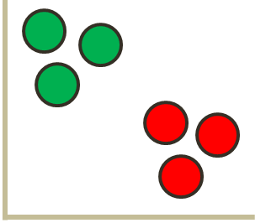
Understanding the role of the root endophytic bacterial community
Assembly
Composition
Function
Relative Abundance
Biomass
Notes:
In order to understand the role of the endophytic bacterial community we decided to study the community in three different ways. We first wanted to understand how the communities are assembled. Here we have three different bacterial species represented by the different shapes. In this toy example we only see the circles and triangles able to occupy the interior of the roots. This means there is some type of force not allowing the squares to occupy this space. With composition, we will look at individuals of the same plant host and measure the similarity or dissimilarity of the composition within and between hosts. We can visualize this using an ordination plot which will show clustering of points if the individuals have the same endophytic root communities or separation if they have dissimilar endophytic root communities.

Slide 10
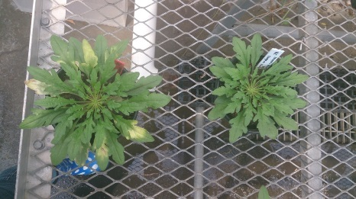
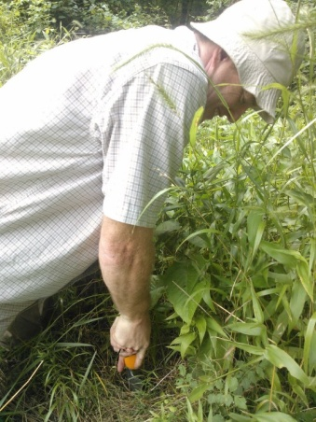

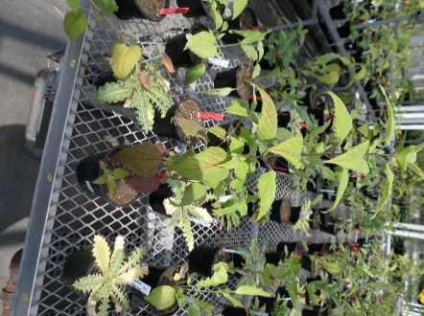
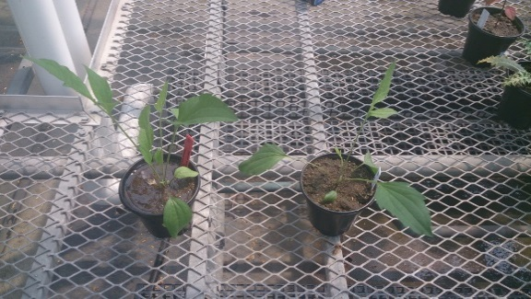
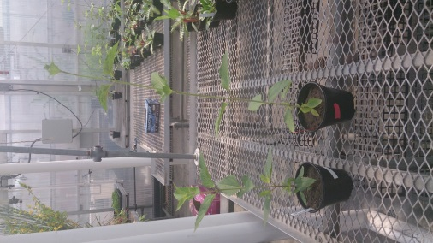
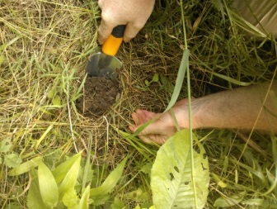
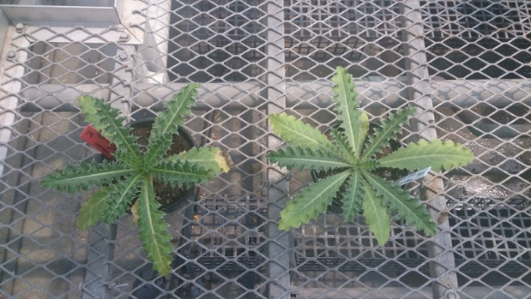
Conyza
canadensis
Non- Autoclaved
Carduus nutans
Soil 1
Autoclaved
Monarda
fistulosa
Non- Autoclaved
Conyza canadensis
Soil 2
Autoclaved
Ratibida
pinnata
Non- Autoclaved
Heliopsis helianthoides
Soil 3
Autoclaved
Heliopsis helianthoides
Non- Autoclaved
Monarda fistulosa
Soil 4
Autoclaved
Non- Autoclaved
Carduus nutans
Ratibida
pinnata
Soil 5
Autoclaved
Total = 550 pots
Notes:
These are the 5 plant hosts we used for the experiment. I’m going to show you using one plant host what we did for all of them. We collected soil which had solely that plant host present. Then we autoclaved a portion of the soil in order to disturb the microbial community by reducing the number of species present.

Slide 11
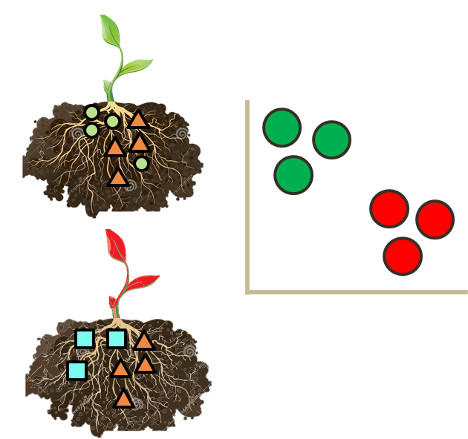
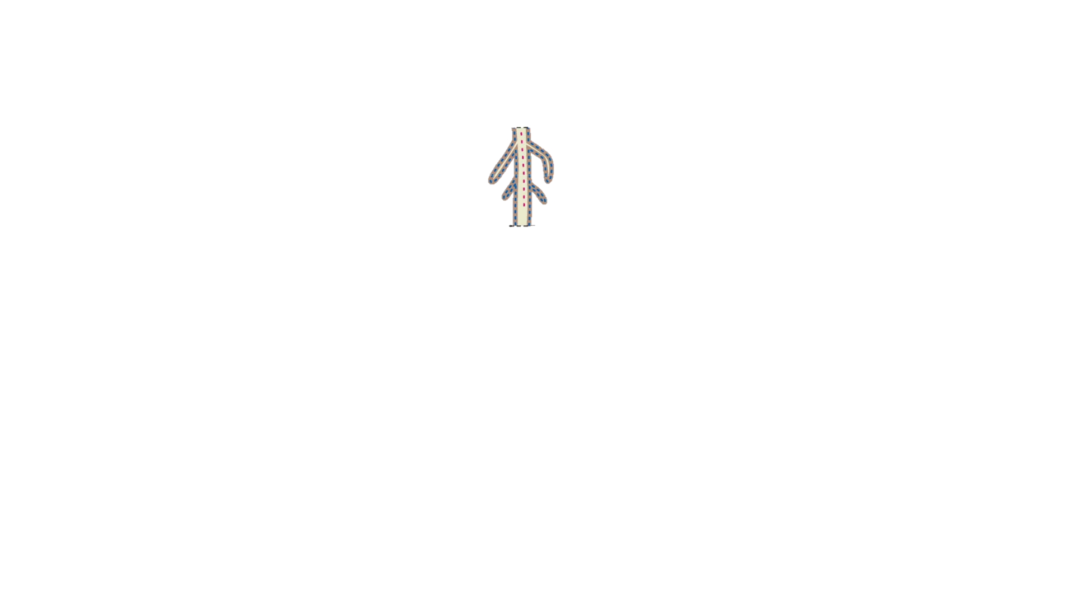

Culture independent method for studying root bacterial communities
Amplify 16S rRNA
gene
Washed
Sonicated
Streptomyces scabiei
Streptomyces clavuligerus
Rhizobium leguminosarum
Greengenes database

Slide 12




Metrics used to study diversity within and between communities
Alpha ($α$) = 2
Beta ($β$)= 1 same, 1 different
Alpha ($α$) = 2
Gamma ($γ$) = 3

Slide 13
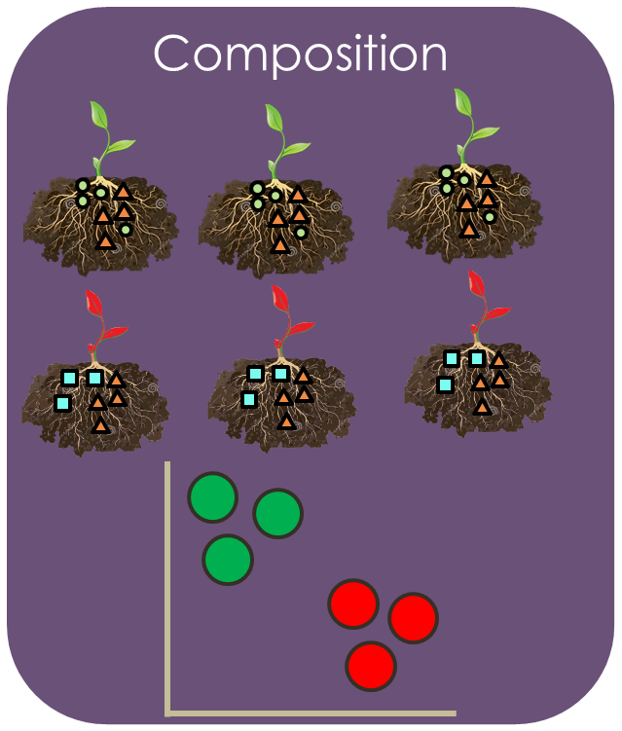
Understanding the role of the root endophytic bacterial community
Assembly
Function
Relative Abundance
Biomass
Notes:
Just say it is an ordination plot. 595 OTUs for the entire project and on each root had more than 30 individuals.

Slide 14
Assembly of microbial communities can be studied using models from community ecology
Random Model
Deterministic Model
Selection
Woodcook et al FEMS Microbial Ecology 2007;van der Plas et al. Ecological Archives. 2012; Diaz et al. Journal of Vegetation Science 1998.; Weiher et al. Oikos 1995.; Czaran et al PNAS 2002

Slide 15
Creating a null model to test the strengths of random vs. deterministic processes
Regional Species Pool = Y
In collaboration with Myers lab.

Slide 16
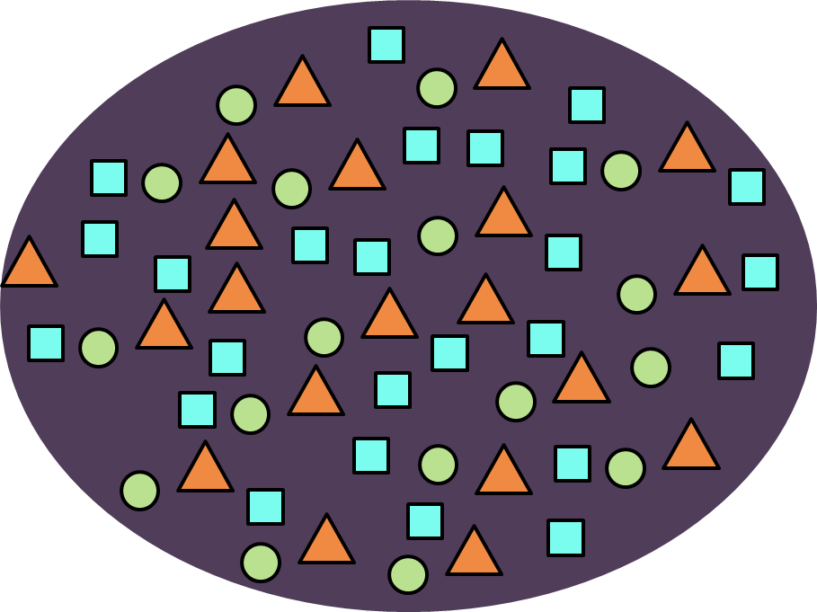
Creating a null model to test the strengths of deterministic vs. stochastic processes
Regional Species Pool = Y
In collaboration with Myers lab.

Slide 17


Creating a null model to test the strengths of deterministic vs. stochastic processes
A : # of$β$_{expected} >$β$_{observed}
B : # of$β$_{expected} =$β$_{observed}
RC = (A + 0.5B)/1000
$β$= $\frac{γ}{α}$
In collaboration with Myers lab.
Notes:
What this values actually is is the probability of getting the observed or fewer shared species given randomization from the species pool. so a RC value of 0.5 is perfectly random. species (observed communities are as different as possible given the species pool). A value of 0 means you have 0 % chance of getting observed or fewer shared species (observed communities are as similar as possible given the species pool). You have a 50% chance of getting the observed or fewer. A value of 1 means you have a 100% chance of getting observed or fewer shared

Slide 18

Creating a null model to test the strengths of deterministic vs. stochastic processes
A : # of $SS$_{expected} > $SS$_{observed}
B : # of $SS$_{expected} = $SS$_{observed}
RC = (A + 0.5B)/1000
RC = 0
RC = 0.5
RC = 1
Deterministic Similar Communities
Deterministic
Different Communities
Random
In collaboration with Myers lab.

Slide 19
Root endophytic communities are assembled by deterministic processes
RC Values
Representative: Soil – Heliopsis helianthoides
In collaboration with Myers lab.
Notes:
In the soil heliopsis helianthodies but same in every soil type and across antibiotic treatment.

Slide 20
Understanding the role of the root endophytic bacterial community
Assembly
Composition
Function
Relative Abundance
Biomass

Slide 21
Interrogation of root endophytic bacterial communities by 16S rRNA sequencing
Relative Abundance
Relative Abundance
1
2
3

Slide 22
Plant host control assemblage of root endophytic bacterial communities
Monarda fistulosa
CAP2 [2.8%]
Conyza canadensis
Heliopsis helianthoides
Carduus nutans
Ratibida pinnata
Adonis p < 0.001
R² = 0.11002
Adonis pairwise (FDR) p < 0.01
CAP1 [4.1%]
Notes:
Most are environmental bacteria from water and soil habitats; however, some Comamonadaceae are also pathogens, and others have been described from earthworms, rumen fluid, and human clinical samples.

Slide 23
Plant host control assemblage of root endophytic bacterial communities
CAP2 [2.8%]
Adonis p < 0.001
R² = 0.11002
CAP1 [4.1%]
Notes:
Most are environmental bacteria from water and soil habitats; however, some Comamonadaceae are also pathogens, and others have been described from earthworms, rumen fluid, and human clinical samples.
Over 100 OTUs differentially expressed between samples 67% reside in the Proteobacteria phylum.

Slide 24
Understanding the role of the root endophytic bacterial community
Assembly
Composition
Function
Relative Abundance
Biomass

Slide 25
Plants respond to absence of bacteria in a host specific manner
*
*
ANOVA p < 0.001
*

Slide 26
Plant biomass may be affected by abundance of bacterial species
Representative: Plant Host – Ratibida pinnata
Notes:
Two of the taxa that were enriched, Ochrobactrum sp. and Sphingomonas sp., have been identified as potential growth enhancing bacteria in previous experiments [130, 131]. Additionally, the depletion of certain OTUs belonging to the family Planctomycetaceae, Legionellaceae and Chitinophagaceae were consistent across plant species.

Slide 27
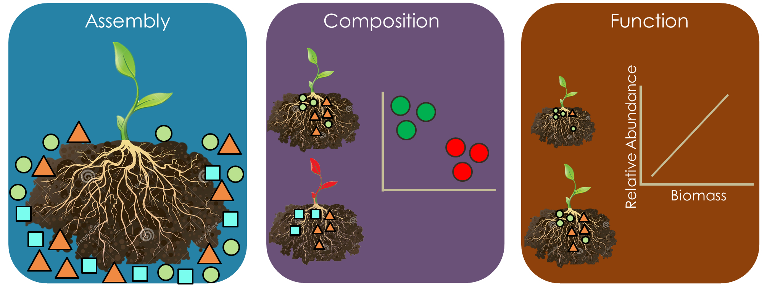
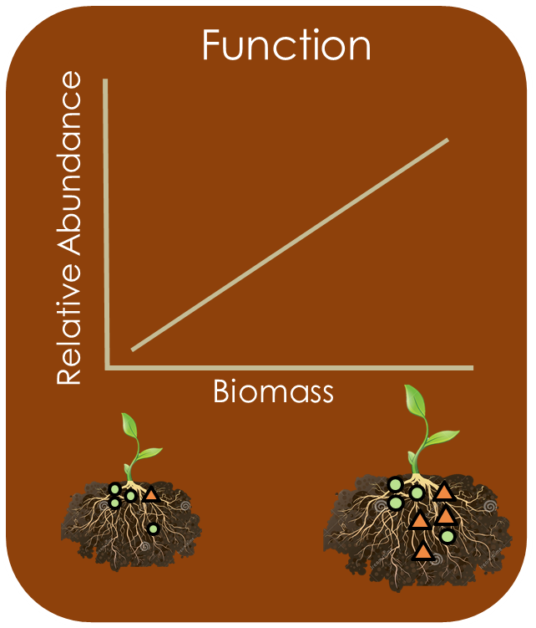
Lessons Learned: Plant Root Project
Driven by non-random processes
Suggests that host control
composition
Promote plant growth and potentially limit growth of pathogens

Slide 28
Complex microbial communities serve important functions in every environment
Zareen Khan et al. Current Plant Biology 2016; Hacquard et al. Cell Host & Microbe Review 2015

Slide 29


Assembly, composition and function of Microbial Communities in Plant Roots
Evaluation of culture based and independent methods to Characterize the Microbial Community of Human Urine
Bladder

Slide 30
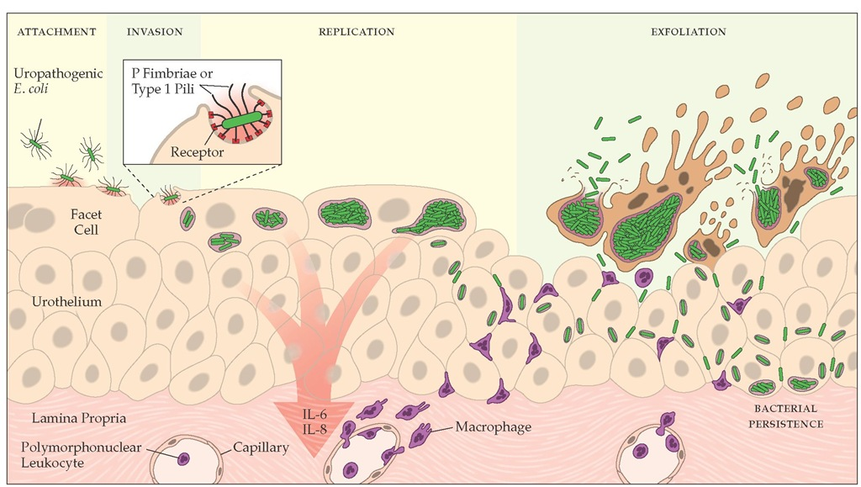
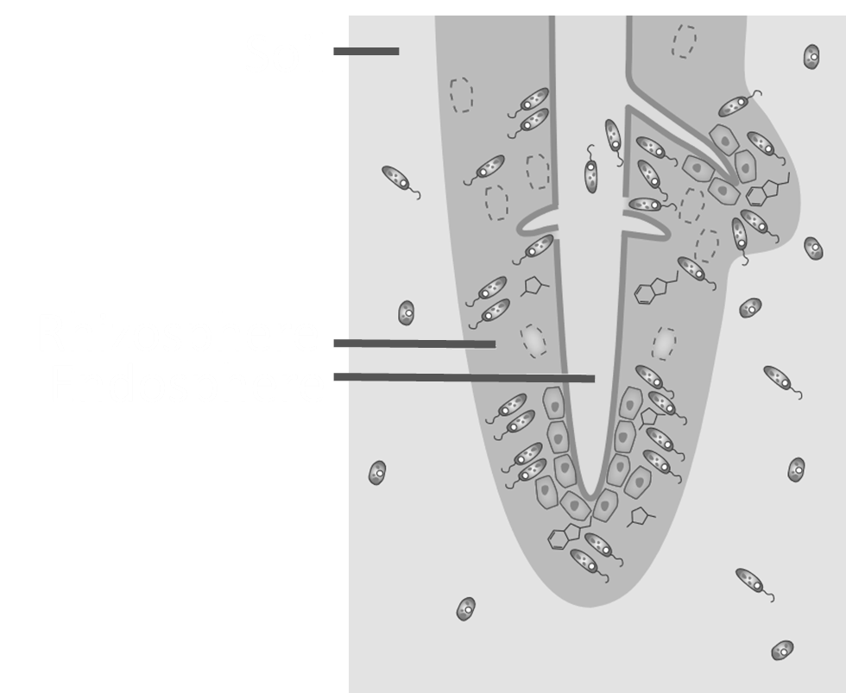
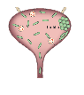
Urinary Tract Infections are a substantial problem in the United States
Most common bacterial infection – 150 million worldwide each year
Account for 10.5 million doctor office visits
2-3 million emergency department visits
Cost $3.5 billion per year
http://what-when-how.com/acp-medicine/urinary-tract-infections-part-1/

Slide 31

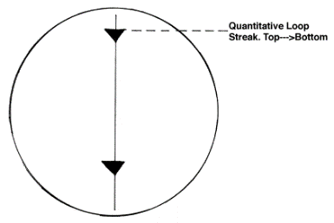
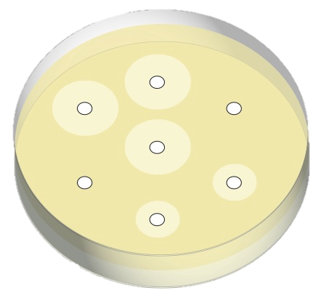
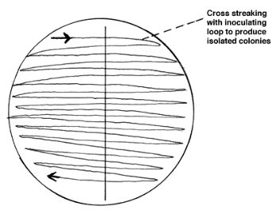
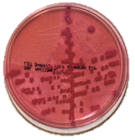
UTIs are diagnosed based on the gold standard which many physicians do not use
Symptoms
Presence of pyuria
Dysuria
Urgency
Frequency
Suprapubic pain
Gold
Standard
95%
of practitioners will prescribe antibiotics before bacterial investigation
Antibiotic Susceptibility Testing
McCarty et al The American Journal of Medicine 1999, http://myrome.org/portal/urinary-tract-infection-dipstick-urinalysis. Mehnert-Kay American Family Physician 2005, Leis et al Infection Control and Hospital Epidemiology 2013, Wienkens et al Family Practice 2003, Schmiemann et al Deutsches Ärzteblatt International 2010

Slide 32
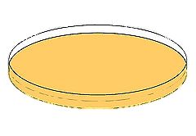
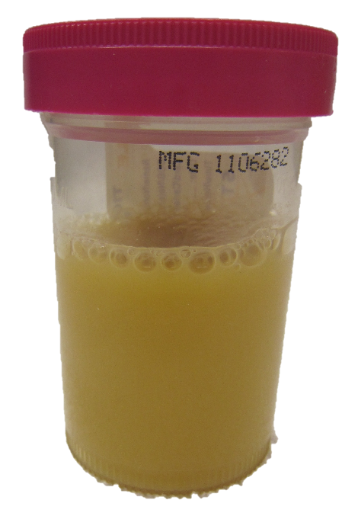
Only patients with symptoms and specimens classified as positive are diagnosed with an UTI
✓
Culture +
Multiple species
?
Insignificant
No Growth
In collaboration with Burnham lab.

Slide 33
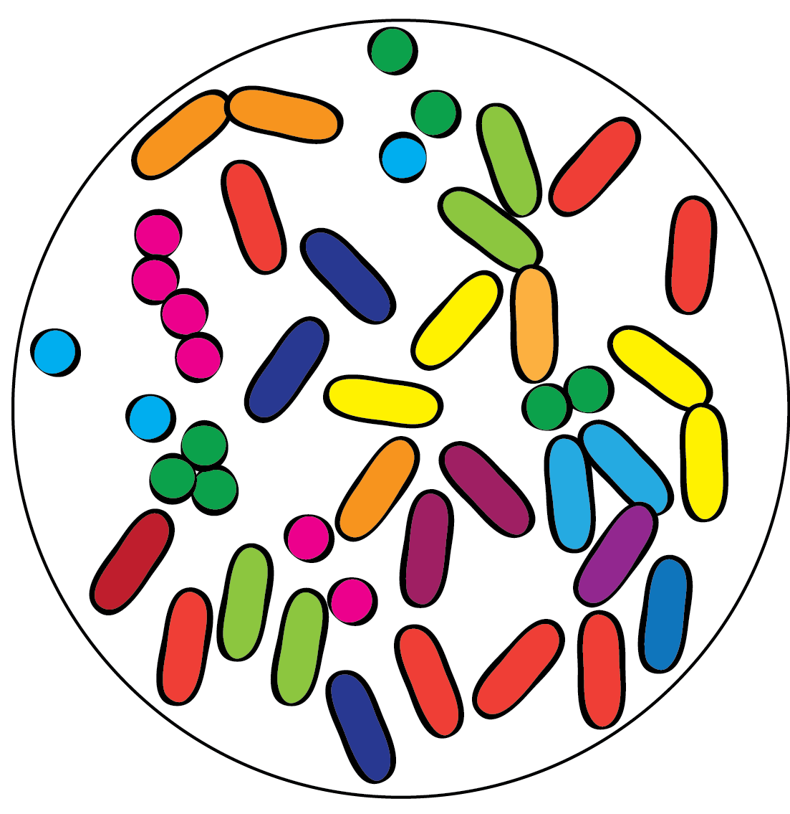
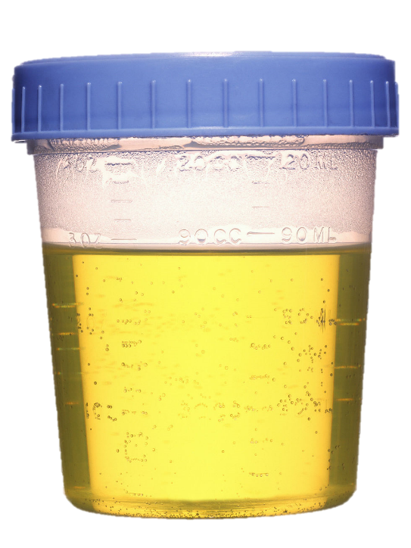
Next-generation sequencing circumvents culturing bias
Bacteria are not readily culturable
Urine is sterile
Asymptomatic Urine
All bacteria are discovered using sequencing
Urine is not sterile
Siddiqui et al BMC Microbiology 2011, Hilt et al J. Clin. Microbiol. 2014, Lewis et al Frontiers in cellular and infection microbiology 2013
Notes:
Great plate count anomaly

Slide 34
Classification system becomes complicated with the presence of a urine microbiota
✓
Culture +
?
Multiple species
Insignificant
No Growth
Asymptomatic
In collaboration with Burnham lab.
Notes:
1 uL was plated to each of a BAP and MAC using a 1 uL calibrated loop and incubated at 35C in CO2 for 24 hours. This standard of care testing was used to classify the urines as “positive”, “insig”, “contam”, “neg”, etc.

Slide 35
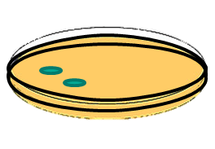
Time series analysis of asymptomatic patients to study stable state
Asymptomatic Urine
Collection 1
Collection 2
Collection 3

Slide 36
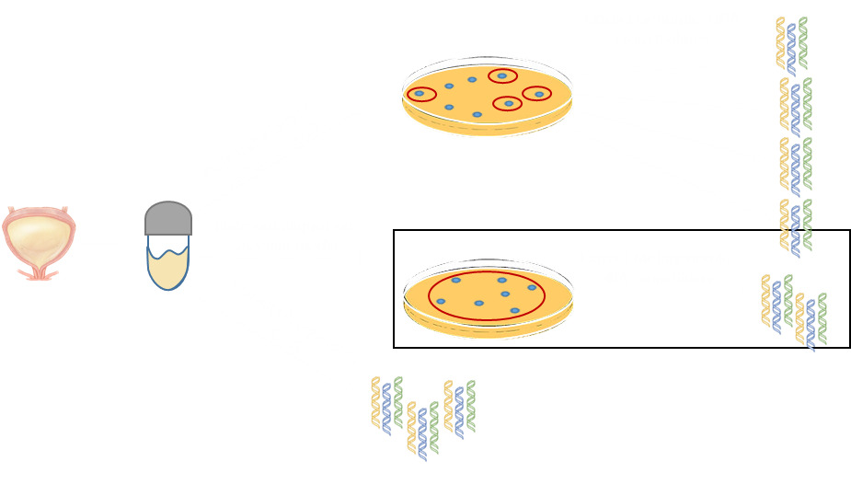
Identifying putative pathogens through culture dependent and independent methods
In collaboration with Burnham lab.
Notes:
Blood Agar and MacConkey

Slide 37

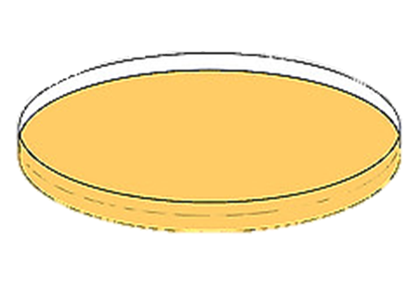
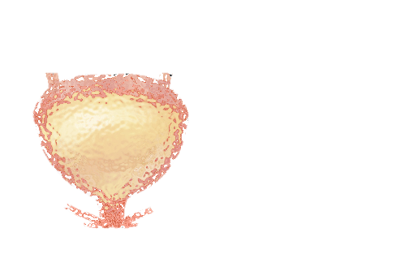


Demographics and Microbiome Cohort Details
Demographics
Cultured
Microbiome
Direct Sequenced Microbiome
103
64
36
1
2
30
30
17
Females
White
Black
Asian
Not specified
Asymptomatic
Asymptomatic
Insignificant
59
35
21
1
2
48
48
69
Males
White
Black
Asian
Not specified
Culture +
Culture +
No-Growth
7
Contaminated
In collaboration with Burnham lab.

Slide 38
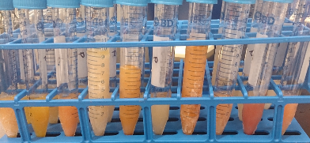
Demographics and Microbiome Cohort Details
Predicted Isolates
n = 224
In collaboration with Burnham lab.

Slide 39
Is the urine microbiota in a state of dysbiosis during an infection?
Microbiome Composition
Isolate
Composition
Function
1
2
Metabolic pathway
3
Culture +
Asymptomatic

Slide 40
Is the urine microbiota in a state of dysbiosis during an infection?
Microbiome Composition
Isolate
Composition
Function
1
2
Metabolic pathway
3
Culture +
Asymptomatic

Slide 41
Asymptomatic microbiome is compositionally different from putative UTI microbiome
Cultured Slurry
Microbiome
Direct Sequenced Microbiome
In collaboration with Burnham lab.

Slide 42
Direct sequencing revealed putative pathogens undiscovered through culturing
Cultured Slurry Microbiome
Direct Sequenced
Microbiome
Culture +
Culture +
Asymptomatic
Asymptomatic
Insignificant
No Growth
Multiple Species
In collaboration with Burnham lab.
Notes:
Bacteriodetes are recovered with direct sequencing and not culturing.

Slide 43
Cultured slurry microbiome recapitulates the direct sequenced microbiome composition
Cultured Slurry Microbiome
Direct Sequenced
Microbiome
Comparison
P = 2.2 x 10⁻¹⁶
% of Urine Reads
Mapped to Slurries
Asymptomatic
Culture +

Slide 44
Putative UTI microbiome could contain more than one pathogen
Isolate
Slurry
Urine
Isolate
Slurry
Urine
Isolate
Slurry
Urine
Isolate
Slurry
Urine

Slide 45
Is the urine microbiota in a state of dysbiosis during an infection?
Microbiome Composition
Isolate
Composition
Function
1
2
Metabolic pathway
3
Culture +
Asymptomatic

Slide 46
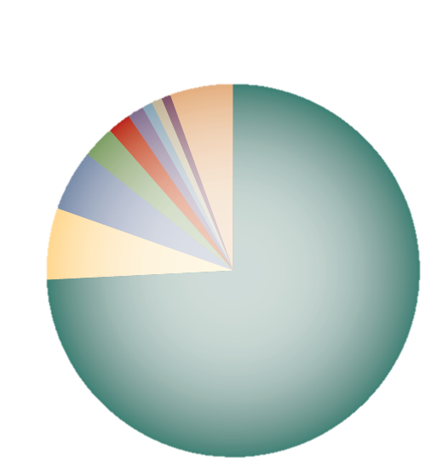
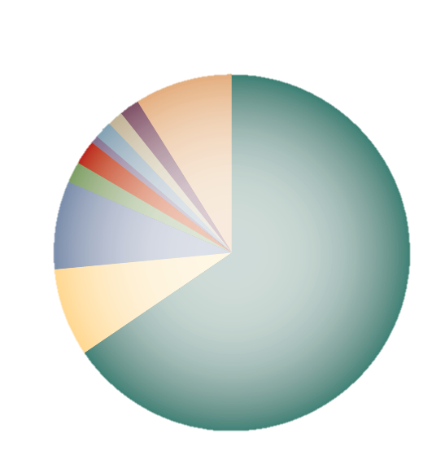
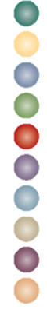
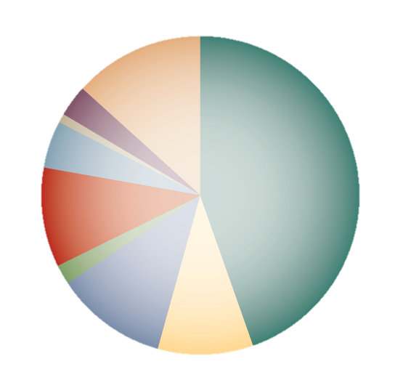
E. coli is the most common uropathogen but how clonal are isolates from the same patient?
Outpatients
Hospital patients
Nursing home patients
Escherichia coli
Klebsiella pneumoniae
Enterococcus sp.
Streptococcus agalactlae
Proteus mirabilis
Staphylococcus saprophyticus
Viridans streptococci
Klebsiella oxytoca
Pseudomonas aeruginosa
Other
Silverman J., et al Current Urology Report 2013, Foxman Nature Reviews 2010

Slide 47
Similar strains of isolates do not have similar antibiotic profiles
B2
F
D
E
B1
A
Notes:
Unlike other B2, ST 131s are able to produce extended-spectrum β-lactamases, such as CTX-M-15 and almost all are resistant to fluoroquinolones. Moreover, ST131 E. coli isolates are considered to be truly pathogenic, due its ability to cause disease in different settings such as the community and hospital and the large number of virulence-associated genes they contain.
A (6.67%), B1 (10%), B2 (62.5%), D (16.6%), and F (4.2%) (Figure 3-5).
F/M – Nitrofurantoin – (not effective for kidneys and appears to be safe during pregnancy) - Nitrofurantoin interferes with the production of bacterial proteins, DNA, and cell walls.
Cipro – Ciprofloxacin - fluoroquinolone (flor-o-KWIN-o-lone) antibiotic that fights bacteria in the body.
CRO – Ceftriaxone – third generation cephalosporin antibiotic. It works by interfering with the formation of the bacteria's cell wall so that the wall ruptures, resulting in the death of the bacteria
Bladder infection (cystitis) – fluroquinolone or tmp/smx or nitrofurantoin
Kidney infection (pyelonephritis) – ciprofloxacin or 3rd generation cephalosporin or tmp/smx
Urethra infection (Urethritis) – cefexime
CZ – Cefazolin - first-generation cephalosporins
CTT – Cefotetan - second-generation cephalosporin
FEP - Cefepime - fourth-generation cephalosporin antibiotic
CAZ - Ceftazidime - third-generation cephalosporins

Slide 48
Intra-variation within patients demonstrates UTIs could be a multi-strain infection
F
B1
Clade F is a newly emerging phylogroup associated with multi-drug resistance
Johnson et al J Clin Microbiology 2017

Slide 49
Is the urine microbiota in dysbiosis during an infection?
Microbiome Composition
Isolate
Composition
Function
1
2
Metabolic pathway
3
Culture +
Asymptomatic

Slide 50
Asymptomatic urine is functionally different from putative suspected UTI urine
Notes:
Bacteriocins are toxins produced by bacteria to inhibit the growth of similar or closely related bacteria. If we were able to isolate these bacteriocins this could be a new form of treatment for UTIs. SopB is a protein which helps bacteria avoid lysosomal degradation. Vaccine antigens could be made for SopB which could help treat UTIs without the use of antibiotics.
It does this by hijac human’s cells ability to produce proteins involved in endocytic trafficking. These events help the bacteria avoid lysosomal degradation.

Slide 51
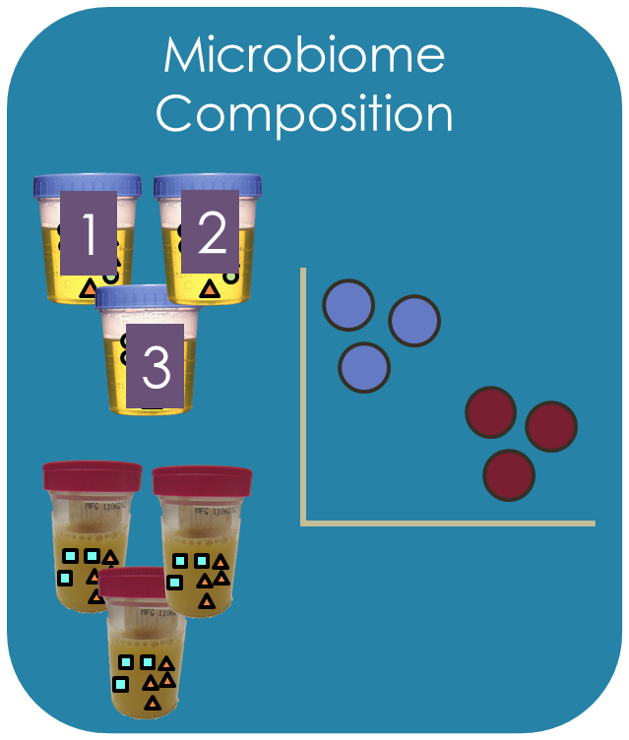
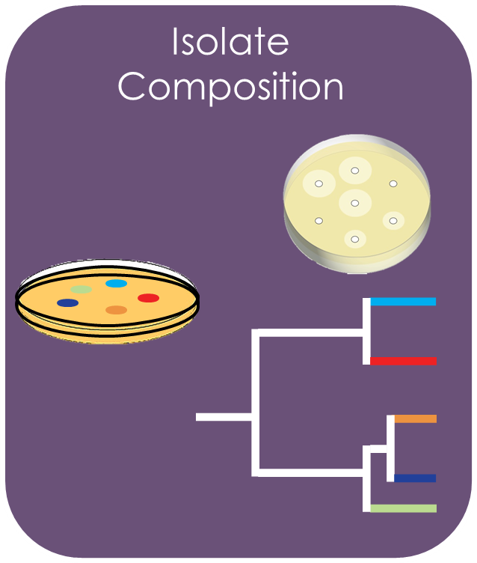
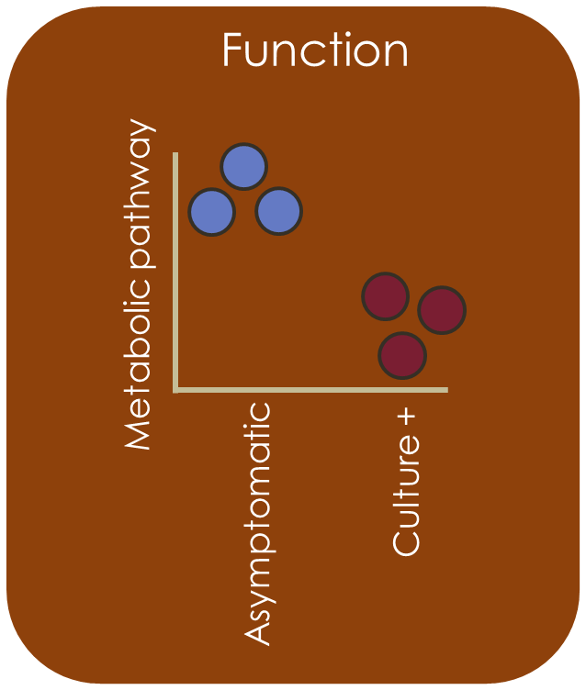
Lessons Learned: UTI project
Asymptomatic urine is stable over time.
Urine microbiome is in an alternative state during an infection.
Similar strain types can have different susceptibility profiles.
Different metabolic pathways could provide a new PCR assay for UTI diagnostics and treatment options.

Slide 52
Lessons Learned and Future Directions
Microbiome play important roles in the host but need to have controlled experiments that test these hypothesis directly.
Microbiome is functionally and taxonomically diverse; therefore, need controlled experiments before suggesting new therapy solutions or including microbes in restoration efforts.

Slide 53
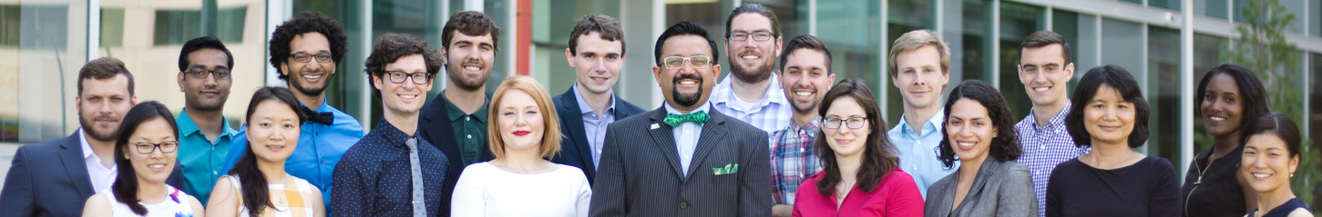



Thank you!
The Dantas Lab
Thesis Committee
Gautam Dantas
Scott Mangan
Jonathan Myers
Ting Wang
Carey-Ann Burnham
Barbara Kunkel
Chair: Justin Fay
Burnham Lab
Carey-Ann Burnham
Meghan Wallace
Gautam Dantas
Mitch Pesesky
Aimee Moore
Kevin Forsberg
Molly Gibson
Amy Langdon
Bin Wang
Terence Crofts
Aki Yoneda
Erica Pehrsson
Patrick Gonzales
Pablo Tsukayama
Sanket Patel
Nathan Crook
Manish Boolchandani
Nick Goldner
Christopher Bulow
Drew Gasparrini
Aura Ferreiro
Sherry Sun
Alaric D’Souza
Robert Potter
Bert Berla
Gretchen Walljasper
Tayte Campbell
Jie Sun
Winston Anthony
Eric Keen
Mangan Lab
Scott Mangan
Claudia Stein
Myers Lab
Jonathan Myers
Christopher Catano
Center for Genome Sciences
Jess Hosington-Lopez
Brian Koebbe
Eric Martin
Funding
National Science Foundation Graduate Research Fellowship DGE-1143945
Mellon Mays

Slide 54
Asymptomatic vs Culture +

Slide 55
Asymptomatic vs No Growth

Slide 56
Asymptomatic vs Insignificant

Slide 57
Asymptomatic vs Multiple Species

Slide 58
Proteobacteria is more prevalent over time and Actinobacteria is more abundant in younger patients
Age Groups
A = 19-49
B = 50 – 69
C = 70 +

Slide 59
Asymptomatic urine microbiome is stable over time
1
dissimilar
Cultured
Microbiome
Direct Sequenced Microbiome
AS = Asymptomatic Slurry
AU = Asymptomatic Urine
Bray-Curtis distance
0
similar
P = 1.2 x 10⁻¹³
P = 1.6 x 10-6
Inter AS
Intra AS
Inter AU
Intra AU

Slide 60
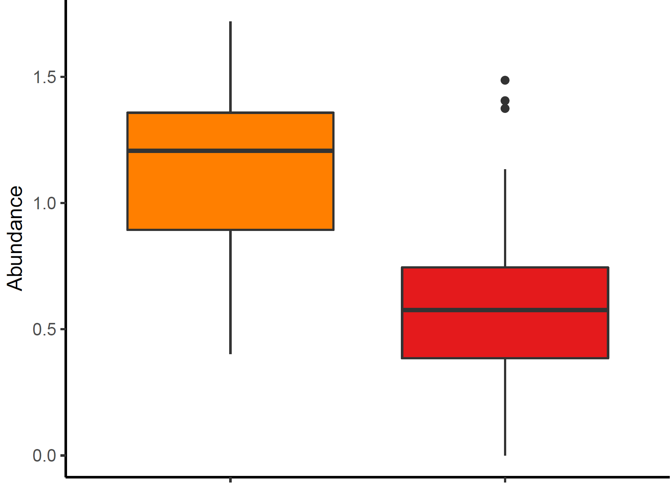


Figure 4
Cultured
Uncultured
Comparison
*
*
a
b
c
Shannon Diversity Index
% of Urine Reads Mapping to Slurries
Shannon Diversity Index
Permutation ANOVA
p = 2.11 x 10-⁹
Permutation ANOVA
p = 2.2 x 10⁻¹⁶
Notes:
Add the insignificants and contaminated to the uncultured for Shannon diversity

Slide 61

Cultured dependent and independent methods can elucidate the function of microbiomes
Susceptibility Testing
Population Genomics
Virulence Genes
Metabolic Pathways

Slide 63


Slide 65

A and B1 do cluster together
Notes:
http://mbio.asm.org/content/5/4/e01075-14.full – Theirs clustered together A/B1

Slide 66


Furthering our understanding of UTIs using a bacterial community perspective rather than studying only UPECs
Aim 2, Manuscript 1
Causations of UTIs
Urine is not sterile
Silverman J., et al. Current Urology Report 2013. Siddiqui et al BMC Microbiology 2011
Notes:
A major risk factor for an antibiotic resistant UTI is prior antibiotic use.
Possible modes of UTI recurrence. Recurrent UTIs can be
introduced from a number of sources. (1) The same UTI-causing strain
(green bacteria) persists in the gut and repeatedly reinoculates the
bladder. (2) A different strain (red bacteria) is introduced first into the
gut and then colonizes the bladder. (3) Quiescent bacteria reside in the
bladder epithelium and re-emerge periodically to cause same-strain UTI
(green bacteria). (4) A new strain of bacteria is introduced directly into
the peritoneal area from the environment (blue bacteria

Slide 67



Can Host Genotype Alter Strength of Processes During Two Step Selection Process for Root Microbiota Differentiation
Aim 1, Manuscript 1
Null Model
Edaphic factors
Processes
Drift
Speciation
Rhizodeposits and cell wall features
Dispersal
Deterministic Model
Processes
Drift
Host genotype factors
Speciation
Dispersal
Acidobacteria
Selection
Actinobacteria
Bacteriodetes and Firmicutes
Proteobacteria
Bulgarelli et al. Annual Review of Plant Biology 2013
Notes:
A two-step selection model for root microbiota differentiation. Edaphic factors determine the structure of bacterial communities in soil biomes. In the first differentiation step, rhizodeposits and host cell wall features promote the growth of organotrophic bacteria, thereby initiating a soil biome community shift. In the second step, convergent host genotype–dependent selection close to and within the root corpus fine-tunes community profiles thriving on the rhizoplane and within plant roots.

Slide 68




The Increasing Threat of Antibiotic Resistance
30% of Antibiotics are unnecessary or incorrectly prescribed
Centers for Disease Control and Prevention. Antibiotic Resistance Threats in the United States, 2013 (http://www.cdc.gov/drugresistance/threat-report-2013/); Cooper and Schlaes 2011

Slide 69


Urine from healthy patients are not sterile
Females
Males
Siddiqui et al. BMC Microbiology 2011; Dong et al. Plos One 2011
Notes:
Males – looked at the V1-V3 region (comparing swabs and urine samples between males infected with an STI and those not infected with an STI)

Slide 70
Isolates Next Generation Sequencing Analysis Pipeline
Aim 2, Manuscript 1
Demultiplex Reads
Quality Filtering
Remove low quality samples
Assembly of Reads
Metaphlan
SNAP
Redo velvet assembly with short reads and long contigs
Extract longest contigs from Bowtie2
SPADES (untrusted contigs - Velvet + trusted contigs – Bowtie2)
Bowtie2
Map reads to ordered contigs
Produce SAM files
Index BAM files
Metagenemark
Run Pilon
Resfams
Virulence HMM
CARD

Slide 71
Isolates Next Generation Sequencing Analysis Pipeline
Aim 2, Manuscript 1
Parameters
seed mismatches | 2
palindrome clip threshold | 30
simple clip threshold | 10
min Adapter length | 1
keep both Reads | TRUE
window size | 4
required quality | 20
leading | 10
trailing | 10
min length | 60
Stats
Average N50 | 249,819
Average length of longest contig | 672,629
Average total bases in contigs | 5,545,658

Slide 72
Isolates Next Generation Sequencing Analysis Pipeline
Aim 2, Manuscript 1
Post Filtering Stats
Avg % of Reads Kept | 32%
Avg # of Reads | 468030.1
FW Reads Avg Length | 143.31
FW Reads Avg EE | 0.24
RV Reads Avg Length | 141.82
RV Reads Avg EE | 0.25
Post Human Filtering
Avg # of FW Cont. | 48.64
Avg # of RV Cont. | 234.64
Avg # of Reads | 467757.4
Avg % of Reads Kept | 99.94%
Notes:
Calculating expected errors: It turns out that it is easy to calculate the expected number of errors: it is the sum of the error probabilities. The most probable number of errors (E*) is also easy to calculate. First calculate E = expected errors = sum P_e. Then round down to the nearest integer, and this is the most probable number of errors. In symbols: E* = floor(E). For example, if E < 1, then the most probable number of errors is zero. Proofs of these results are given in Edgar & Flybjerg (2014).

Slide 73
Human Reads Filtering from Slurry and Urine Samples

Slide 74
Read distributions study cohort
Aim 2, Manuscript 1
Range from
483 – 12,842,213
In collaboration with Burnham lab.

Slide 75


Slide 76

Number of Reads Used for Asymptomatic Specimen

Slide 77

Number of Reads Used for Contaminated and Positive Specimen

Slide 78

Urines vs Slurries Accumulation Curve

Slide 79

MLST TYPES

Slide 80
Virulence Factors

Slide 81

Notes:
Hultgren group’s paper (Flores-Mireles et al Urinary Tract infections: epidemiology mechanisms of infection and treatment options)
For capsular antigens look at kps genes

Slide 82
Notes:
Hultgren group’s paper (Flores-Mireles et al Urinary Tract infections: epidemiology mechanisms of infection and treatment options)

Slide 83

P pili
papA_major_pilin_protein_PapA_[P_fimbriae]-1
PapX_protein_[P_fimbriae]-1
P_pilus_assembly_protein_PapJ_[P_fimbriae]
PapC_outer_membrane_usher_protein_[P_fimbriae]-5
Notes:
Taken from Kuehn et al (Scott Hultgren group) https://www.nature.com/nature/journal/v356/n6366/pdf/356252a0.pdf

Slide 84

S pili
S_fimbriae_periplasmic_chaperone_SfaE-1
sfaB_major_pilu_subunit_operon_regulatory_protein_PapB_[S_fimbriae]-1
Notes:
https://link.springer.com/article/10.1007/s00249-009-0552-8

Slide 85

Type 1 pili
FimH_minor_component_of_type_1_fimbriae_[Type_I_fimbriae]-1
fimI_fimbrial_protein_involved_in_type_1_pilus_biosynthesis_[Type_I_fimbriae]-1
fimE_recombinase_involved_in_phase_variation,_regulator_for_fimA_[Type_I_fimbriae]-1
fimA_Fimbrial_protein_[Type_I_fimbriae]-1
FimD_fimbrial_outer_membrane_usher_protein_[Type_I_fimbriae]-2
type_I_pilus_chaperone_protein_FimD_[Type_I_fimbriae]-1
FimC_outer_membrane_usher_protein_[Type_I_fimbriae]-3
FimH is sufficient to mediate bacterial internalization – Martinez et al (Hultgren group)
Notes:
https://academic.oup.com/jid/article/183/Supplement_1/S36/2191070/Structure-and-Function-of-Escherichia-coli-Type-1

Slide 86
Notes:
Hultgren group’s paper (Flores-Mireles et al Urinary Tract infections: epidemiology mechanisms of infection and treatment options)
Dr adhesion – includes fimbrial adhesion and nonfimbrial adhesions and is termed Dr for the blood group antigen, a common receptor for this family of adhesions
Found Intracellular adhesion proteins (ICAMs)

Slide 87

HlyA
hemolysin_activator_HlyB_[Contact-dependent_inhibition_CDI_system]-1
hemolysin_activating_lysine-acyltransferase_HlyC_[Alpha-hemolysin]-2
hemolysin_secretion_protein_HlyD_[Alpha-hemolysin]-1
hlyA_hemolysin_structural_protein_HlyA_[Alpha-hemolysin]-6
Notes:
Blood agar plate assay for hemolytic activity. (A) CP9 plate. (B) Enlargement of the section indicated by a box on the CP9 plate. (C) CP9ΔhlyA₁::cat plate. (D) Enlargement of the section indicated by a box on the CP9ΔhlyA₁::cat plate. (E) CP9ΔhlyA₁::cat(pKG8) plate. (F) Enlargement of the section indicated by a box on the CP9ΔhlyA₁::cat(pKG8) plate. Strains were streaked on plates, incubated overnight at 37°C, and photographed digitally with a Nikon Coolpix 995 camera.

Slide 88
Notes:
Hultgren group’s paper (Flores-Mireles et al Urinary Tract infections: epidemiology mechanisms of infection and treatment options)
Dr adhesion – includes fimbrial adhesion and nonfimbrial adhesions and is termed Dr for the blood group antigen, a common receptor for this family of adhesions
Found Intracellular adhesion proteins (ICAMs)

Slide 89

Different siderophores and their natural producers

Slide 90

Yersiniabactin
ybtQ_ABC_transporter_protein_[Yersiniabactin_siderophore]-1
fyuA_pesticin_outer_membrane_receptor_[Yersiniabactin]-3
yersiniabactin_biosynthetic_protein_YbtT_[Yersiniabactin_siderophore]-1
ybtS_salicylate_synthase-anthranilate_synthase_Irp9_[Yersiniabactin_siderophore]-1
ybtA_putative_AraC_type_regulator_protein_[Yersiniabactin_siderophore]-1
Yersiniabactin_siderophore_biosynthetic_protein_irp1-6
yersiniabactin-iron_transporter_permease_YbtX_[Yersiniabactin_siderophore]-1
Notes:
Siderophore found in pathogenic bacteria such as Yersinia pestis. Yersiniabactin is a four ring structure composed of carbon, hydrogen, nitrogen, oxygen, and sulfur
Should I use - antiSMASH is available at http://antismash.secondarymetabolites.org.

Slide 91

Enterobactin
fepG_ferric_enterobactin_transport_protein-1
fepC_ATP-binding_component_of_ferric_enterobactin_transport-1
fepB_ferric_enterobactin_binding_protein_[Enterobactin_transport]-1
enterobactin_synthase_multienzyme_complex_component_ATP-dependent_entF-4
fepD_ferrienterobactin_ABC_transporter_permease-1
fepA_outer_membrane_receptor_for_ferric_enterobactin-2
Notes:
Transferrin, an iron carrier protein that is conserved among mammals, birds, fish, and amphibians, has a strong affinity for iron (K_{d} = ~10⁻²⁰)
binds iron with an even lower K_{d} of ~10⁻⁴⁹
lipocalin 2 - functions as a bacteriostatic agent by specifically binding and sequestering enterobactin

Slide 92
Conyza
canadensis
Non- Autoclaved (14)
Carduus nutans
Soil 1
Autoclaved (6)
Monarda
fistulosa
Non- Autoclaved (14)
Conyza canadensis
Soil 2
Autoclaved (6)
Ratibida
pinnata
Non- Autoclaved (14)
Heliopsis helianthoides
Soil 3
Autoclaved (6)
Heliopsis helianthoides
Non- Autoclaved (14)
Monarda fistulosa
Soil 4
Autoclaved (6)
Non- Autoclaved (24)
Carduus nutans
Ratibida
pinnata
Soil 5
Autoclaved (6)
Total = 550 pots
Notes:
These are the 5 plant hosts we used for the experiment. I’m going to show you using one plant host what we did for all of them. We collected soil which had solely that plant host present. Then we autoclaved a portion of the soil in order to disturb the microbial community by reducing the number of species present.

Slide 93

Supplementary Figure 1.
Notes:
Observed species richness for each plant host in each soil trained by each plant host.

Slide 94




Supplementary Figure 2.
B.
Adonis p < 0.008
R² = 0.019
A.
Adonis p < 0.001
R² = 0.073
D.
Adonis p < 0.001
R² = 0.078
C.
Adonis p < 0.007
R² = 0.006
Notes:
Bacterial communities were altered by host, soil history, antibiotics and soil autoclave treatment. Ordination of Bray-Cutis dissimilarities shows clustering of root endophytic bacterial communities by (a) plant host (b) soil history (c) antibiotic treatment, (d) autoclaving treatment

Slide 95

Supplementary Figure 3.
*
*
Live vs Autoclaved -Permutation Anova - p < 0.001
Autoclaved - Antibiotics vs No-Antibiotics – Permutation ANOVA p<.001

Slide 96


Supplementary Figure 4.
B.
A.
Adonis p < 0.001
R² = 0.2367
Notes:
Ordination of Bray-Cutis dissimilarities shows clustering of root endophytic bacterial communities by plant host for plants grown in sterile soils.

Slide 97
Total biomass was higher in Monarda’s soil when compared to other soils
Aim 1, Manuscript 1
Linear Regression p < .001 R² 73%
Mantel Pearson’s p = 0.042 (R 0.15)
Mantel Pearson’s p = 0.0025 (R .26)
ADONIS - p < .001
Notes:
Re make this figure with the colors from the pcoa.

Slide 98




Fig 1.
*
C.
A.
Live vs Autoclaved -Permutation Anova - p < 0.001
*
*
*
Field Soil
Autoclaved Field Soil
*
*
*
D.
B.
*
Soil -Permutation Anova - p < 0.0001
*
*
*
Total Biomass
Field Soil
Notes:
(a) Plant biomass is dramatically reduced in field autoclaved soils but the presence of antibiotics did not have an effect on plant biomass. (b) All plants grown in M. fistulosa’s soil had higher biomass when compared to other soils except R. pinnata’s. Plant biomass of each plant host (c) not treated with antibiotics (d) treated with antibiotics

Slide 99
Burkholderia bryophila only found in Carduus nutans
Notes:
Research has shown that B. bryophila demonstrates anti-fungal activity against phytopathogens and the growth of plant-associated properties.

Slide 100
OTU classified as Caulobacteraceae
Notes:
Prosthecate cells often attach to surfaces with the prostheca at one end and forming polarly flagellated swarming cells at the other end. Prostheca of several cells may form rosettes.

Slide 101

Compounds released by plant roots included in concept of rhizodeposition
Wichern et al Nitrogen rhizodeposition in agricultural crops: Methods, estimates and future prospects 2008

Slide 102

23 Bacterial Phyla But Only 6 Dominate the Soil Microbiome
Actinobacteria
Aquificae
Bacteroidetes/Chlorobi group
Chlamydiae/Verrucomicrobia group
Chloroflexi (green nonsulfur bacteria)
Chrysiogenetes
Cyanobacteria (blue-green algae)
Deferribacteres
Deinococcus-Thermus
Dictyoglomi
Elusimicrobia
Fibrobacteres/Acidobacteria group
Firmicutes
Fusobacteria
Gemmatimonadetes
Nitropsirae
Plantomycetes
Proteobacteria
Spirochaetes
Synergistetes
Tenericutes
Thermodesulfobacteria
Thermotogae
Bulgarelli et al. Annual Reviews Plant Biology 2013
Notes:
Firmicutes larges Bacteria phylum with more than 250 genera
Proteobacteria 2nd largest bacteria phyla

Slide 103

Notes:
OTU – Novosphingobium (Conyza depleted of this otu)
Burkholderia bryophila

Slide 104


Closely Related Plant Species Have Similar Bacterial Communities
Aim 1, Manuscript 1
Linear Regression p < .001 R² 73%
Bacterial Communities Bray Curtis Dissimilarity Dendrogram
Carduus nutans
Heliopsis helianthoides
Plant Phylogenetic Relatedness
Ratibida pinnata
Conyza canadensis
Monarda fistulosa
ADONIS - p < .001

Slide 105



Supplementary Figure 6.
A.
B.
Adonis p < 0.001
R² = 0.019
Enterobacteriaceae
Bacillus
Rhodospirillaceae
Pirellulaceae
Conexibacteraceae
Notes:
Post sonication and post wash bacterial communities are different from the bacteria found in the endophytic compartment. (a) Ordination of Bray-Cutis dissimilarities shows clustering of root endophytic bacterial communities by location. (b) Heatmap of OTUs which are differentially found in the endophytic compartment compared to in the post sonication and post wash samples.
Pirellulaceae - ammonia-oxidizing bacteria correlations with pH

Slide 106


Supplementary Figure 3.
Notes:
Heatmap and dendrogram of OTUs differentially abundant in root endophytic bacterial communities of plant hosts.

Slide 107


Slide 108

V4 and V2 most accurate
Vilo et al. Metagenomics 2012.
Notes:
RDP Classifier accuracy evaluated with different 16S rRNA variable regions by using 0.5% simulated sequencing
errors. The sequences from the SILVA database were clustered into 1,607 genera; then one sequence was randomly selected
from each genus cluster in order to create test datasets. For each test dataset, we extracted its V1–V3, V3–V5, and V6–V9
combined regions, and V1 to V9 individuals regions. Then, we simulated sequencing errors by replacing a 0.5% of the
nucleotides by an “N”, from all fragments in the dataset, randomly. The taxonomic classification of the selected full-length
gene sequences were then compared to the classification of its V1–V3, V3–V5, and V6–V9 combined regions, and V1 to V9
individuals regions. The above procedure was repeated ten times by randomly sampling with replacements from each species
cluster. The x-axis displays the variable regions evaluated at each of the different taxonomic levels (i.e., genus, family, order,
class, and phylum). The y-axis shows the average percentages of classification accuracy. The accuracies were evaluated
by using the RDP Classifier confidence threshold scores of 0.7 (blue), 0.8 (red), and 0.9 (green), with the 95% confidence
interval being plotted.

Slide 109


Full Length vs Variable Regions
Huse et al. Plos Genetics 2008.

